Slide 1
Chongqing University of Technology
ATAI
Advanced Technique of Artificial Intelligence
Chongqing Unive
Pushing Paraphrase Away from Original Sentence:
A Multi-Round Paraphrase Generation Approach
Code： https://github.com/L-Zhe/BTmPG
（ACL-2021)
Reported by Zicong Dou

Slide 2
Chongqing University of Technology
ATAI
Advanced Technique of Artificial Intelligence
Chongqing University of Technology
1. Introduction
2. Approach
3. Experiments

Slide 3
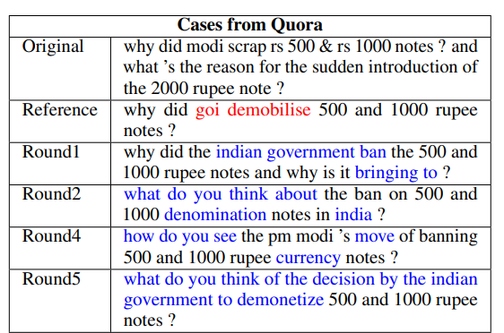
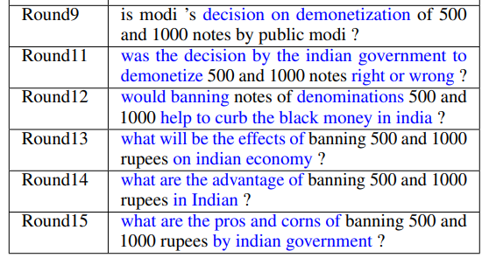
Introduction
Original：为什么莫迪废除500卢比和1000卢比的纸币? 为什么突然要发行2000卢比纸币呢?
Reference：为什么印度要废除500卢比和1000卢比纸币?

Slide 4
Introduction
• We propose BTmPG (BackTranslation guided multi-round Paraphrase Generation), which leverages multi-round paraphrase generation to improve diversity and employs back-translation to preserve semantic information.
Notes:
我们提出了BTmPG (BackTranslation guided multi-round改述生成)，该方法利用多轮改述生成来提高多样性，并利用反向翻译来保留语义信息。

Slide 5
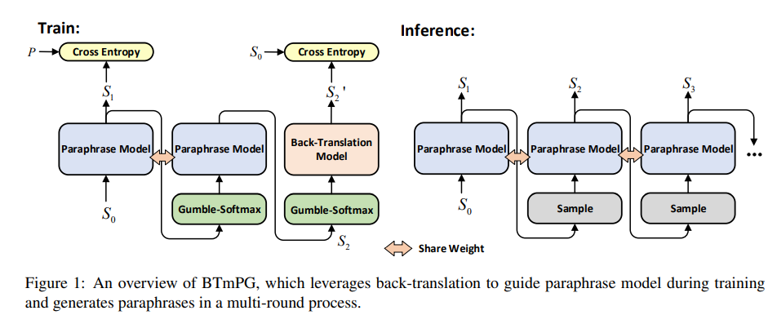
Approach

Slide 6
Approach

Slide 7
Paraphrase Model

Slide 8
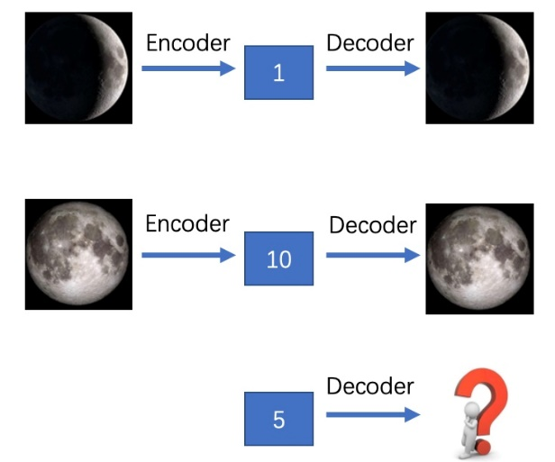
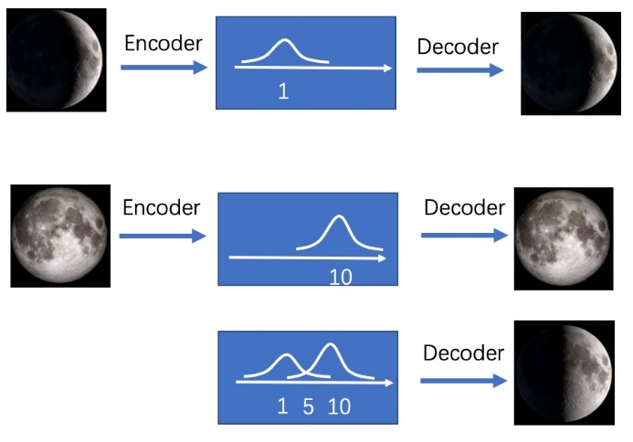
Approach

Slide 9
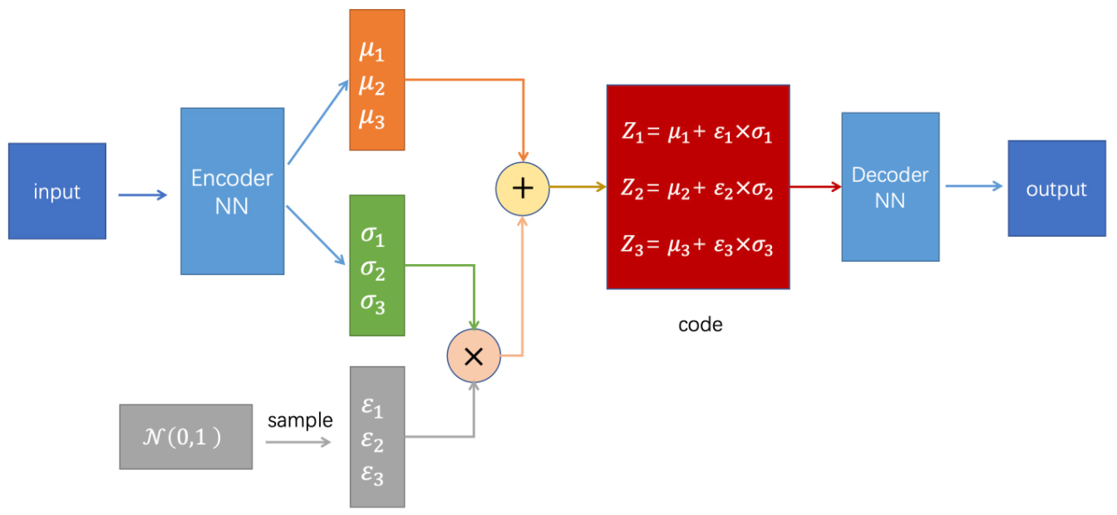
Approach
VAE (Variational Auto-Encoder)

Slide 10
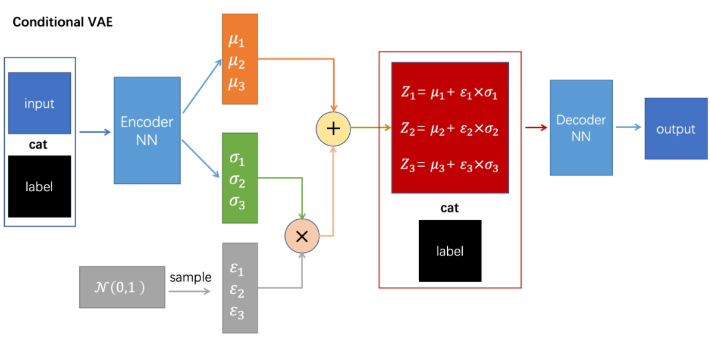
Paraphrase Model
paraphrase encoder
original encoder

Slide 11
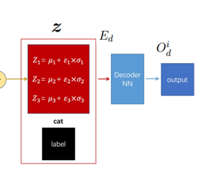
Paraphrase Model

Slide 12
Paraphrase Model

Slide 13
Back-Translation Model

Slide 14
Approach

Slide 15
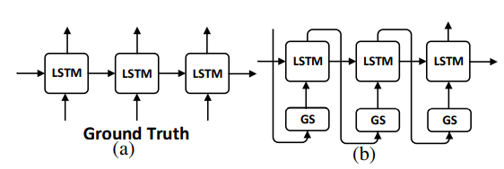
Approach

Slide 16
Approach

Slide 17
Approach
OOV：
One Hot encodings：
teacher-forcing ：在训练网络过程中，每次不使用上一个state的输出作为下一个state的输入，而是直接使用训练数据的标准答案(ground truth)的对应上一项作为下一个state的输入。

Slide 18
Experiments

Slide 19
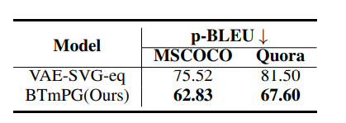
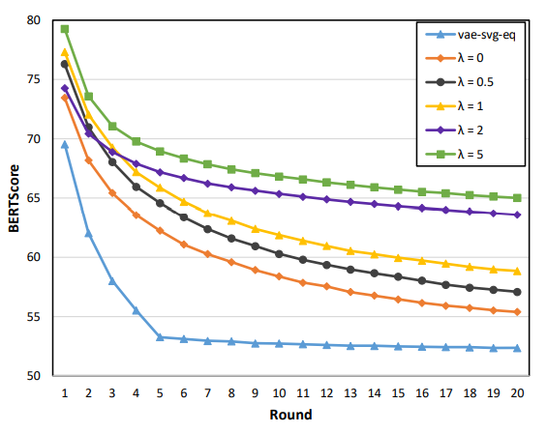
Experiments

Slide 20
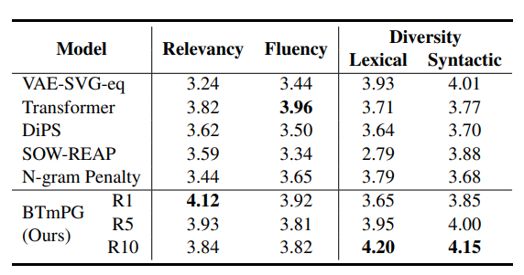
Experiments

Slide 21
Experiments

Slide 22
Thank you！

